Slide 1
Industrial Controls

Slide 2
Industrial Controls
Industrial control devices range from simple knife switches to more complex solid state sensors. The type of control device selected depends upon the specific application. There are three distinct ways to control an application:
Manually Operated Switches
Mechanically Operated Switches
Electromechanical Switches

Slide 3
Industrial Controls
Manually Operated Switches
  Manually operated switches are triggered with the use of human power. There are five types of manually operated switches:
  Knife
  Toggle
  Push Button
  Rotary-Selector
  Manual Starter

Slide 4
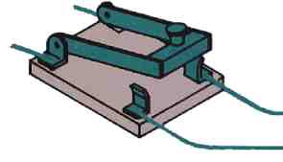
Knife Switch
The knife switch is the oldest and simplest type of switch consisting of a blade and jaw mechanism.
Knife switches are primarily used in large electrical distribution situations.
Knife switch

Slide 5
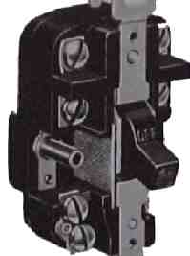
Toggle Switch
Toggle switches replaced knife switches for safety and speed of operation. Toggle switches use a lever to close or open contacts.
Toggle switch

Slide 6
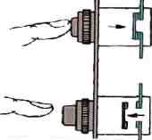
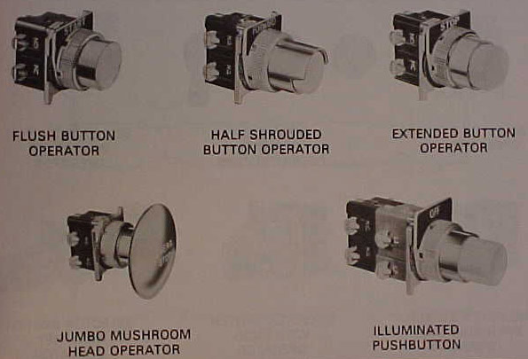
Pushbutton Switch
A pushbutton switch is a two-position switch used to select a load either on or off.
The pushbutton may consist of one or more contact blocks; denoting the switch as normally open (no) or normally closed (nc), an operator of some type, a legend plate to denote function and mounting rings or washers to adjust and hold the device in an enclosure.
Depress Pushbutton
Pushbutton Switches
Release Pushbutton

Slide 7
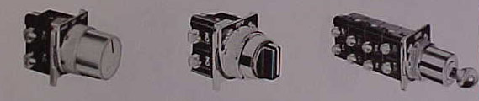
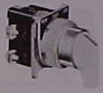
Rotary-Selector Switch
Rotary-selector switches are constructed in the same fashion as a pushbutton. A rotary-selector switch requires the operator to rotate a knob, lever, or key to open and close contacts. Additionally, rotary-selector switches are used to select or determine one of several different circuit possibilities from a two-position on/off switch to a four-position key switch.
Coin
Knob
Key
Rotary-Selector Switch

Slide 8
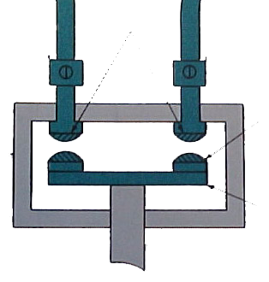
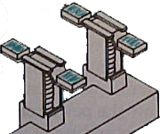
Manual Contactor
A manual contactor is a device for any electrical circuit that repeatedly establishes and interrupts an electrical power circuit. When a switch is engaged, contacts touch allowing electrical power to flow.
Manual Contactor
Contacts
Moveable Contacts
Contacts
Conductive Bar

Slide 9
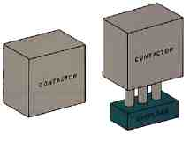
Manual Starter Switch
Manual Starter
Manual Starter switches are contactors with an additional overload protection device used only for motors. The overload protection device is required to protect the motor from destroying itself under an overloaded situation.

Slide 10
Industrial Controls
Mechanically Operated Switches
  Mechanically operated switches are triggered with the use of some other moving part. There are four types of mechanically operated switches:
  Limit
  Mercury
  Snap Acting
  Motor Protection

Slide 11
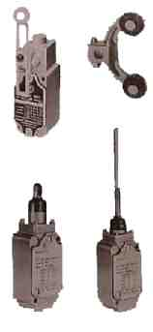
Limit Switch
Limit switches are used to convert mechanical motion into an electrical signal. They accomplish this conversion by using some type of lever to force open or closed a set of contacts within the limit switch.
Typical applications of limit switches include conveyors, elevator control, counting, positioning, detecting, sequencing, and monitoring.
Limit Switches

Slide 12
Mercury Switch
Mercury switches utilize the electrical properties of mercury to complete a circuit. Within a glass tube, a pool of mercury is able to move around allowing it to make contact with different contacts for different reasons. Usually a mercury switch is used in low voltage situations such as a household thermostat.

Slide 13
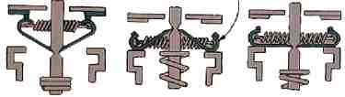
Snap Acting Switch
A snap acting switch is used in applications that require a set of contacts that will snap open or closed to eliminate arcing and burning.
Bimetallic Strip
As the bimetallic strip heats or cools, pressure is exerted on the spring, eventually causing enough force to instantly snap the plunger up or down

Slide 14
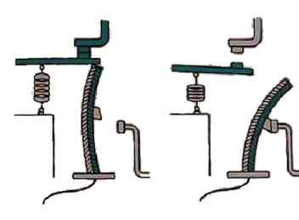
Motor Protection Switch
Motor protection switches are located on or in a motor to protect the motor from overloading situations. They sense either the amount of heat generated or the amount of current consumed by the motor. Prior to motor damage, they directly or indirectly disconnect the motor from the power circuit.
Before Overload
After Overload
Bimetallic
metal

Slide 15
Industrial Controls
Electromechanical Switches
  Electromechanical operated switches are triggered with the use electricity. There are three types of electromechanically operated switches:
  Relays
  Solenoids
  Semi-conductive

Slide 16

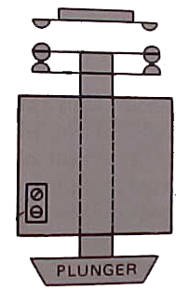
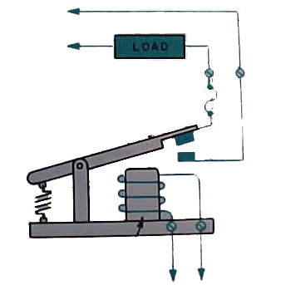
Relays
Relays are electromechanical devices that either use a small input voltage (24v) to control a larger output voltage (230/460v) or use an input voltage to control two or more output voltages.
120v
120v
24v
120v
120v
120v
120v
De-energized electromechanical relay
Mechanical relay switch operated by a coil

Slide 17
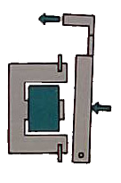
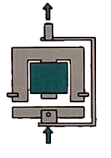
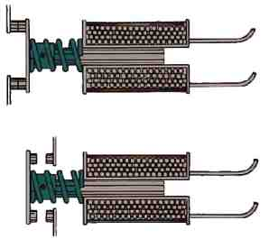
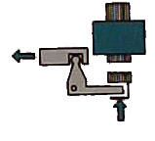

Solenoid Switches
Solenoid switches use simple electromagnetic attraction and repulsion to create some type of useful function. The design of the solenoid determines the type of function created.
Clapper
Vertical Action
N.C. contacts open when energized
Horizontal Action
Bell Crank
N.O. contacts close when energized

Slide 18
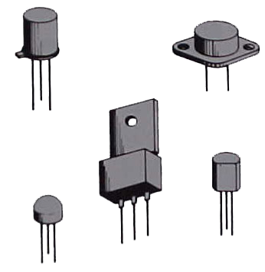
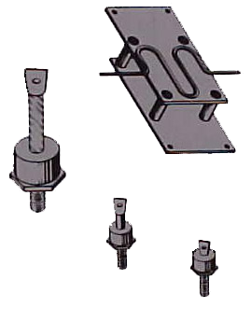
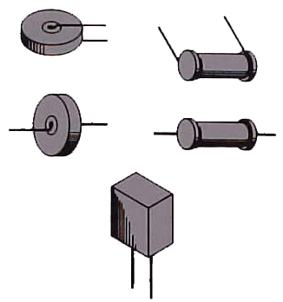
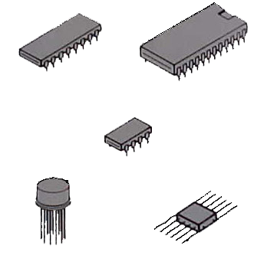
Semi-conductive Switch
Semi-conductive switches use semiconductor technology to control low voltage electricity. Examples include rectifiers, silicon controlled rectifiers, diodes, thermistors, photovoltaic cells, photoconductive cells, resistors, transistors, capacitors and integrated circuits.
Thermistor
Integrated Circuits
Diode
Transistors

